Slide 1
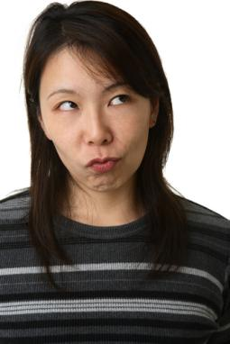
4-1 PAST PARTICIPLE
She has forgotten his name.

Slide 2

4-2 FORMS OF THE PRESENT PERFECT
He has finished all his work.

Slide 3
4-2 FORMS OF THE PRESENT PERFECT
(a) I have worked very hard this year.
(b) The students have worked hard.
(c) Alex has worked very hard.
STATEMENT: have/has + past participle

Slide 4
4-2 FORMS OF THE PRESENT PERFECT
(g) I have not gone home yet.
(h) Fatima has not gone home.
NEGATIVE: have/has + not + past participle

Slide 5
4-2 FORMS OF THE PRESENT PERFECT
(g) I haven’t gone home yet.
(h) Fatima hasn’t gone home.
NEGATIVE: have/has + not + past participle
NEGATIVE CONTRACTION:
have + not = haven’t
has + not = hasn’t

Slide 6

4-2 FORMS OF THE PRESENT PERFECT
(i) Have you read the report?

Slide 7
4-2 FORMS OF THE PRESENT PERFECT
(j) Has Marcy gone home?
(k) How long have you worked there?
QUESTION :
have/has + subject + past participle

Slide 8
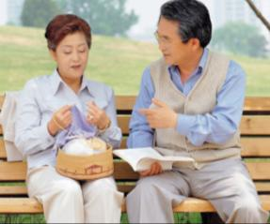
4-2 FORMS OF THE PRESENT PERFECT
(l)
No, I haven’t. I have only read a few pages.
Have you read all of this article?
SHORT ANSWER:
have/haven’t

Slide 9
4-2 FORMS OF THE PRESENT PERFECT
(m)
Has Kyung finished her homework?
Yes, she has. She did it after school.
SHORT ANSWER:
has/hasn’t

Slide 10
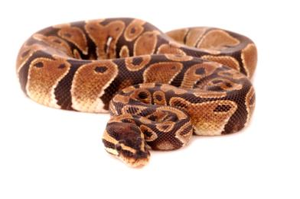
4-2 LET’S PRACTICE
PRESENT PERFECT
you
touch
ever
Have you ever touched
___________________ a snake?

Slide 11
4-2 LET’S PRACTICE
PRESENT PERFECT
touch
never
I’ve never touched
No,
________________
a snake.

Slide 12
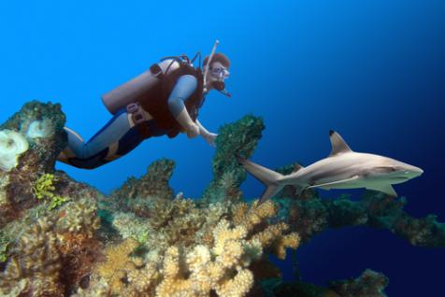
4-2 LET’S PRACTICE
PRESENT PERFECT
Justin
see
ever
_________________ a shark?
Has Justin ever seen

Slide 13
4-2 LET’S PRACTICE
PRESENT PERFECT
Yes, he ___. He saw one near Cape Town,
has
South Africa.

Slide 14
4-3 MEANINGS OF THE PRESENT PERFECT
PRESENT PERFECT
MEANING #1: SOMETHING HAPPENED
BEFORE NOW AT AN UNSPECIFIED TIME

Slide 15
4-3 MEANINGS OF THE PRESENT PERFECT
MEANING #1
(a) Tyler has already taken his first steps.
(b) Zoe hasn’t walked by herself yet.
(c) Have you ever seen Zoe crawl?
occurred before now or
sometime in the past

Slide 16
4-3 MEANINGS OF THE PRESENT PERFECT
MEANING #1
(a) Tyler has already taken his first steps.
(b) Zoe hasn’t walked by herself yet.
(c) Have you ever seen Zoe crawl?
now
before now
X
X
time?

Slide 17
4-3 MEANINGS OF THE PRESENT PERFECT
MEANING #1
(d) Mary has painted portraits many times.
(e) Her students have painted portraits twice.
activity repeated
before now, unspecified past times

Slide 18
4-3 MEANINGS OF THE PRESENT PERFECT
MEANING #1
(d) Mary has painted portraits many times.
(e) Her students have painted portraits twice.
now
before now
X
X
X
X

Slide 19
4-3 MEANINGS OF THE PRESENT PERFECT
PRESENT PERFECT
MEANING #2: A SITUATION BEGAN
IN THE PAST AND CONTINUES TO THE
PRESENT.

Slide 20
4-3 MEANINGS OF THE PRESENT PERFECT
MEANING #2
(f) We’ve worked since 8 o’clock.
(g) I have played the violin for six years.
I learned to play six years ago, and I still
play it.
since
for
present perfect +
past
present

Slide 21
4-3 MEANINGS OF THE PRESENT PERFECT
MEANING #2:
(f) We’ve worked since 8 o’clock.
now
8:00
x
x
x

Slide 22
4-3 LET’S PRACTICE
Kyung has already taken the test.
MEANING #1: Something happened before now at an unspecified time.
OR ?
MEANING #2: A situation began in the
past and continues to the present.

Slide 23
4-3 LET’S PRACTICE
I’ve studied since 8 AM.
MEANING #1: Something happened
before now at an unspecified time
OR ?
MEANING #2: A situation began in the
past and continues to the present

Slide 24
4-3 LET’S PRACTICE
Rosa has been to Italy three times.
MEANING #1: Something happened
before now at an unspecified time
OR ?
MEANING #2: A situation began in the
past and continues to the present

Slide 25
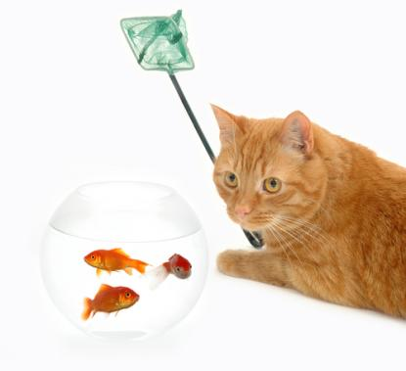
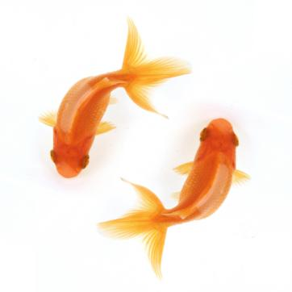
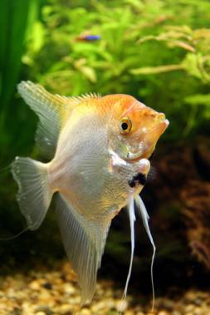
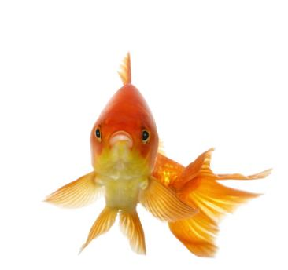
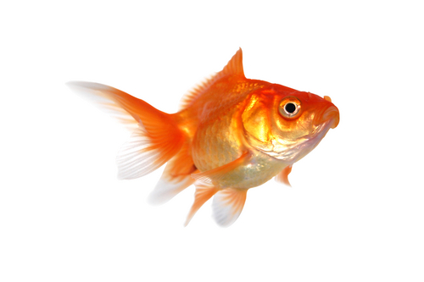
4-4 SIMPLE PAST vs. PRESENT PERFECT
I had an angel fish
when I was a child.
I have had many other
fish since then.

Slide 26
4-4 SIMPLE PAST vs. PRESENT PERFECT
SIMPLE PAST
(a) They completed the game at 4:00.
specific time
PRESENT PERFECT
(b) They have already completed the game.
unspecified time

Slide 27
4-4 SIMPLE PAST vs. PRESENT PERFECT
SIMPLE PAST
(c) I was in Nigeria when I was five years old.
specific time
PRESENT PERFECT
(d) I have been in Nigeria three times.
unspecified time

Slide 28
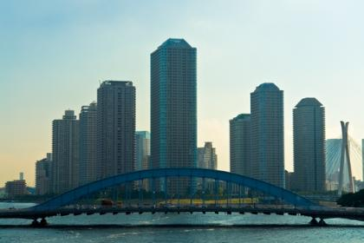
4-4 LET’S PRACTICE
?
SPECIFIED
OR
UNSPECIFIED TIME
We have been in Tokyo
many times.
PRESENT
PERFECT
UNSPECIFIED

Slide 29

4-4 LET’S PRACTICE
?
SPECIFIED
OR
UNSPECIFIED TIME
Barry has never been to Tokyo.
PRESENT
PERFECT
UNSPECIFIED

Slide 30
4-4 LET’S PRACTICE
?
SPECIFIED
OR
UNSPECIFIED TIME
Gina went to Tokyo
last month.
SPECIFIED
SIMPLE PAST

Slide 31

4-5 USING SINCE AND FOR
I have been here since 6:00 AM.

Slide 32
4-5 USING SINCE AND FOR
MAIN CLAUSE
(present perfect)
SINCE-CLAUSE
(simple past)
(f) I have known her since I was fifteen.
(g) Jim has played many sports since he tried soccer.
Since
time clause

Slide 33
4-5 USING SINCE AND FOR
for fifty minutes.
for five hours.
for ten days.
for about six weeks.
for almost two months.
for many years.
for a long time.
(h) I have worked here
For
length of time

Slide 34
4-5 USING SINCE AND FOR
(i) I have worked here for twelve years.
I got a job here twelve years ago, and I still have it.
present perfect + for + length of time
past present
(j) I played sports for fifteen years. I am too busy now.
simple past
past present

Slide 35
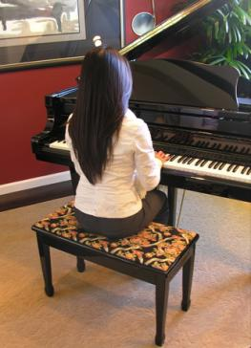
4-5 LET’S PRACTICE
3 hours
she was six
Mary has been playing the piano
since ___________.
she was six
Mary has been playing the piano
for ___________.
three hours

Slide 36

4-5 LET’S PRACTICE
he started school
15 years
Alejandro has studied English
since ________________.
he started school
Alejandro has studied English
for __________________.
fifteen years

Slide 37
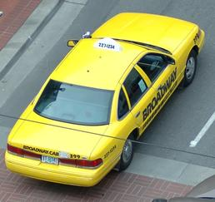
4-5 LET’S PRACTICE
for
since
I have driven a taxi _____ 2006.
since
My uncle has driven a taxi ____ thirty years.
for

Slide 38
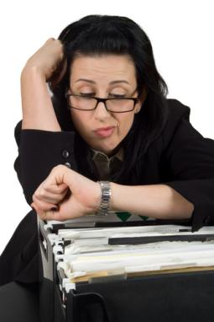
4-6 PRESENT PERFECT PROGRESSIVE
Dee has been working
for ten hours.

Slide 39

4-7 LET’S PRACTICE
PRESENT PERFECT
live
How long ___ your family ______ here?
We __________ here for ten years.
has
lived
have lived

Slide 40
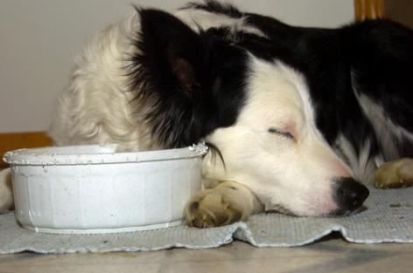
4-8 USING ALREADY, YET, STILL, AND ANYMORE
I already fed the dog.

Slide 41

4-8 USING ALREADY, YET, STILL, AND ANYMORE
ALREADY
(a) I fed the dog thirty minutes ago.
I already fed the dog.
happened before now
Position: midsentence

Slide 42
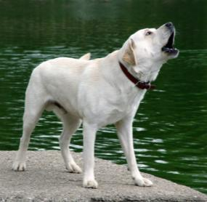
4-8 USING ALREADY, YET, STILL, AND ANYMORE
YET
(b) I usually feed the dog, but I haven’t fed him yet.
did not happen before now
Position: end of sentence

Slide 43
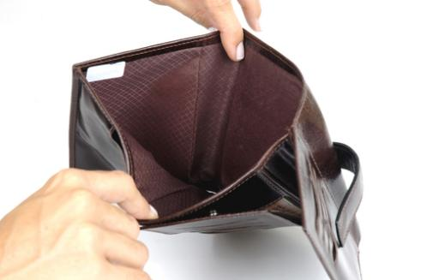
4-8 LET’S PRACTICE
Already
yet
She doesn’t have any money.
She _______ spent it all.
already

